Slide 1
DISCOVERING KNEE OSTEOARTHRITIS USING CNN ENCHANCED WITH ALEX NET

Slide 2
INDEX
Abstract
Objective of project
Problem Statement
Scope & Motivation
Introduction
Literature survey
Existing Method
Disadvantages
Proposed method
Advantages
Project Flow
Hardware and Software Requirements
Architecture
Modules
UML Diagram
Output Screens
Conclusion
References

Slide 3
ABSTRACT
Introducing an innovative approach to early knee osteoarthritis detection, this research leverages a specialized Convolutional Neural Network (CNN) enriched with the sophisticated architectures of AlexNet, MobileNet, and ResNet. Focused on enhancing diagnostic accuracy and efficiency through the analysis of medical imaging data, the integration of these state-of-the-art networks harnesses the power of deep learning. This novel framework exhibits heightened performance in identifying initial indicators of knee osteoarthritis, contributing to advancements in early detection and intervention for this prevalent joint ailment.
Keywords: Knee Osteoarthritis, CNN, AlexNet, MobileNet, ResNet, Medical Imaging, Deep Learning, Diagnostic Precision.

Slide 4
OBJECTIVE OF PROJECT
Enhanced Diagnostics: Implement a specialized Convolutional Neural Network (CNN) with integrated architectures from AlexNet, MobileNet, and ResNet to improve precision in knee osteoarthritis diagnosis.
Early Detection: Utilize deep learning techniques to identify initial indicators, enabling timely intervention for knee osteoarthritis, ultimately contributing to enhanced patient outcomes.
Architectural Integration: Integrate advanced neural network architectures to optimize the system's ability to analyze complex medical imaging datasets, fostering a more comprehensive and accurate diagnostic process.
Medical Advancements: Contribute to the progress in medical diagnostics by developing a novel framework for addressing prevalent joint ailments, particularly knee osteoarthritis. This approach showcases the potential for significant advancements in early detection and intervention strategies, ultimately improving patient care.

Slide 5
PROBLEM STATEMENT
The project addresses the challenge of accurately diagnosing knee osteoarthritis, a prevalent joint ailment, using conventional diagnostic methods that may lack precision and efficiency. The current methods often rely on subjective interpretations and may not detect early indicators of the condition, leading to delayed intervention and suboptimal patient outcomes. Therefore, there is a critical need for a robust and efficient diagnostic system capable of early detection and precise identification of knee osteoarthritis, thereby facilitating timely intervention and improving patient care.

Slide 6
SCOPE AND MOTIVATION
Motivation:
The motivation for this project stems from the existing challenges in accurately diagnosing knee osteoarthritis using traditional methods. The limitations in precision and timeliness in current diagnostic approaches highlight the need for a more sophisticated system. By leveraging deep learning techniques and advanced neural network architectures, the project aspires to contribute to medical advancements, providing a solution that improves the precision and efficiency of knee osteoarthritis diagnosis, ultimately enhancing patient care and outcomes.

Slide 7
Scope:
Utilizing Specialized CNN with AlexNet Architecture: Implementing a dedicated Convolutional Neural Network (CNN) enriched with the advanced architecture of AlexNet to create a robust framework for knee osteoarthritis detection.
Enhanced Diagnostic Accuracy: Analyzing medical imaging data using deep learning techniques to achieve superior diagnostic accuracy, providing healthcare professionals with more precise information for effective decision-making.
Early Detection Capabilities: Developing and implementing early detection capabilities within the system to identify initial indicators of knee osteoarthritis. This aims to facilitate timely intervention and improve patient outcomes.
Integration of Advanced Neural Network Architectures: Exploring the integration of advanced neural network architectures, including MobileNet and ResNet, to optimize the system's ability to process and interpret complex medical imaging datasets. This integration enhances the overall efficiency and effectiveness of the diagnostic process.

Slide 8
INTRODUCTION
Knee osteoarthritis, a prevalent joint ailment characterized by the degeneration of knee cartilage resulting in pain and reduced mobility, underscores the critical need for accurate and early diagnosis. The significance of timely and precise diagnosis cannot be overstated, as it is fundamental to effective intervention and improved patient outcomes.
However, conventional diagnostic methods encounter challenges in providing the requisite precision and timeliness necessary for optimal patient care. This project introduces a sophisticated diagnostic paradigm to address these challenges. Leveraging deep learning techniques, specifically a specialized Convolutional Neural Network (CNN) enriched with the architectural advancements of AlexNet, the system aims to transcend the limitations of existing methods.

Slide 9
INTRODUCTION
Primary Objectives:
Enhancing Diagnostic Accuracy: Employing a specialized CNN with AlexNet architecture to meticulously analyze medical imaging data, aiming to enhance diagnostic accuracy in identifying knee osteoarthritis.
Enabling Early Detection: Developing capabilities for early detection of knee osteoarthritis indicators, ensuring timely intervention and improved patient outcomes.
By pursuing these primary objectives, the research aspires to make a substantial contribution to the field of medical diagnostics, bridging existing gaps and ultimately elevating the standard of patient care in knee osteoarthritis management.

Slide 10
LITERATURE SURVEY
S.NO | YEAR | AUTHORS | TITLE | OUT COMES
1 | IEEE, 2022 | T. Sivakumari; R. Vani | Implementation of AlexNet for Classification of Knee Osteoarthritis | This project explores the use of the AlexNet model for classifying knee osteoarthritis (KOA) severity. By leveraging deep learning technology, the aim is to enhance diagnostic accuracy and reduce the pressure on clinicians. The project assesses the model's performance in comparison to other models, emphasizing the potential of artificial intelligence in improving KOA diagnosis.
2 | IOP journal, 2018 | Anifah, L., Purnomo, M., Mengko, T., Purnama, I | Osteoarthritis severity determination using self organizing map based Gabor kernel. | This research utilizes a Gabor kernel-based x-ray image template to assess knee osteoarthritis severity in Indonesia. Through image processing, learning, and testing stages, the study achieves accuracy rates for different severity levels. Results show promise for the research to serve as a decision support system for medical practitioners in determining KL-Grade on x-ray images of knee osteoarthritis.

Slide 11
LITERATURE SURVEY
S.NO | YEAR | AUTHORS | TITLE | OUT COMES
3 | ICPR, 2016 | Antony, J., McGuinness, K., O’Connor, N.E., Moran, K | Quantifying radiographic knee osteoarthritis severity using deep convolutional neural networks | This paper introduces a superior method for automatically quantifying knee osteoarthritis (OA) severity, utilizing deep convolutional neural networks (CNN). The approach significantly enhances classification accuracy compared to traditional methods, showcasing notable progress on the Osteoarthritis Initiative (OAI) dataset.
4 | IEEE, 2013 | He, K., Sun, J., Tang, X | Labeled Optical Coherence Tomography (OCT) and Chest X-ray Images for Classification | The dataset in "Deep learning-based classification and referral of treatable human diseases" includes validated OCT and Chest X-Ray images. OCT images are split into training and testing sets, labeled by disease type, randomized patient ID, and image number. This dataset is essential for the study's deep learning-based classification and referral of treatable human diseases.

Slide 12
EXISTING SYSTEM
This model emphasizes an existing method that is designed using some of the algorithms of deep learning. Here, the process is performed using CNN, which is one of the transfer learning methods, but it has encountered challenges in achieving high accuracy.
Disadvantages:
Less Feature Compatibility:
The model exhibits limitations in terms of feature compatibility, possibly hindering its ability to effectively capture and analyze relevant features from the input data.
Low Accuracy:
Despite utilizing CNN and transfer learning, the model faces challenges in achieving high accuracy, indicating potential shortcomings in its ability to precisely identify and classify knee osteoarthritis indicators.
Addressing these disadvantages is crucial for optimizing the model's performance and ensuring its effectiveness in enhancing diagnostic accuracy and enabling early detection.

Slide 13
DISADVANTAGES
Computational Complexity: The utilization of advanced architectures such as AlexNet, MobileNet, and ResNet introduces increased computational demands, potentially requiring substantial resources. Managing the computational complexity becomes crucial for practical deployment.
Processing Time: The sophisticated features of AlexNet, MobileNet, and ResNet may lead to extended processing times, particularly when dealing with large medical imaging datasets. Real-time results could be affected, and careful consideration is needed for efficient processing.
Resource Requirements: The enhanced architectures may demand significant computational resources, limiting practicality in settings with constraints. Balancing the trade-off between model complexity and resource availability is essential for widespread applicability.

Slide 14
DISADVANTAGES
Optimization Challenges: Careful optimization strategies are necessary to address the computational complexities of AlexNet, MobileNet, and ResNet. Achieving a balance between high accuracy and efficient deployment requires meticulous optimization.
Deployment Practicality: The disadvantages include potential limitations in deploying the models in environments with restricted computational capabilities. Considering the practicality of implementing advanced architectures like MobileNet and ResNet becomes crucial for successful deployment in diverse healthcare settings.

Slide 15
PROPOSED METHOD
The proposed methodology integrates a specialized Convolutional Neural Network (CNN) with AlexNet, MobileNet, and ResNet architectures for comprehensive knee osteoarthritis detection. The process commences with meticulous data preprocessing, optimizing the dataset for training. The constructed CNN model, enriched with features from AlexNet, MobileNet, and ResNet, undergoes rigorous training and performance evaluation. Key metrics guide optimization, providing insights into the strengths and limitations of each architecture. This multi-architectural approach aims to elevate the accuracy of knee osteoarthritis detection, showcasing the potential advancements achievable through the fusion of CNN, AlexNet, MobileNet, and ResNet capabilities in medical diagnostics.

Slide 16
ADVANTAGES
Enhanced Pattern Recognition: The utilization of a Convolutional Neural Network (CNN) enriched with AlexNet, MobileNet, and ResNet features facilitates superior pattern recognition. This amalgamation allows the model to capture intricate details in knee images, enhancing its diagnostic capabilities.
Hierarchical Learning: The hierarchical learning capabilities of the enhanced CNN, combined with MobileNet and ResNet architectures, contribute to a more nuanced understanding of knee osteoarthritis features. This synergistic approach potentially improves diagnostic accuracy by considering various hierarchical representations.
Flexibility: The proposed method, incorporating features from AlexNet, MobileNet, and ResNet, exhibits flexibility in adapting to diverse datasets. This adaptability makes the model applicable to different scenarios, contributing to its versatility across various medical imaging datasets.

Slide 17
ADVANTAGES
Comparative Analysis: The method enables a comprehensive comparative analysis with existing approaches, providing insights into its efficacy and potential advancements in knee osteoarthritis discovery.
Potential for Further Research: The proposed method sets the stage for potential further research and improvements, fostering advancements in the field of medical image analysis and disease detection.

Slide 18
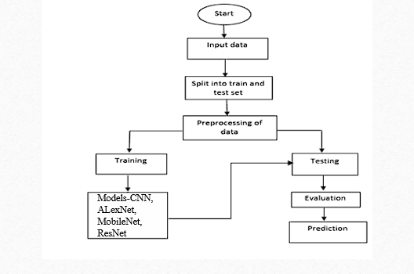
PROJECT FLOW
Figure: work Flow of Proposed system

Slide 19
HARDWARE & SOFTWARE REQUIREMENTS
SOFTWARE REQUIREMENS
Operating System : Windows 7/8/10
Server side Script : HTML, CSS, Bootstrap & JS
Programming Language : Python
Libraries : Flask, Pandas, Tensorflow, Keras, Numpy
IDE/Workbench : VSCode

Slide 20
HARDWARE & SOFTWARE REQUIREMENTS
SOFTWARE REQUIREMENS
Technology : Python 3.6+
Server Deployment : Xampp Server
Database : MySQL

Slide 21
HARDWARE & SOFTWARE REQUIREMENTS
HARDWARE REQUIREMENTS
Processor - I3/Intel Processor
RAM - 4GB (min)
Hard Disk - 128 GB
Key Board - Standard Windows Keyboard
Mouse - Two or Three Button Mouse
Monitor - Any

Slide 22
FUNCTIONAL AND NON-FUNCTIONAL REQUIREMENTS
Requirement’s analysis is very critical process that enables the success of a system or software project to be assessed. Requirements are generally split into two types: Functional and non-functional requirements.
Functional Requirements: These are the requirements that the end user specifically demands as basic facilities that the system should offer. All these functionalities need to be necessarily incorporated into the system as a part of the contract. These are represented or stated in the form of input to be given to the system, the operation performed and the output expected. They are basically the requirements stated by the user which one can see directly in the final product, unlike the non-functional requirements.

Slide 23
FUNCTIONAL AND NON-FUNCTIONAL REQUIREMENTS
Sound Event Detection (SED) systems are designed to recognize and classify various sound events within an audio stream, distinguishing between different types of sounds such as speech, music, environmental noises, and more. The functional requirements of a SED system typically include the ability to accurately detect, classify, and annotate sound events in real-time or from recorded audio. This involves processing audio input, extracting features relevant to sound events, and applying machine learning models to classify these events. The system should support a wide range of sound event classes and be adaptable to different environments..

Slide 24
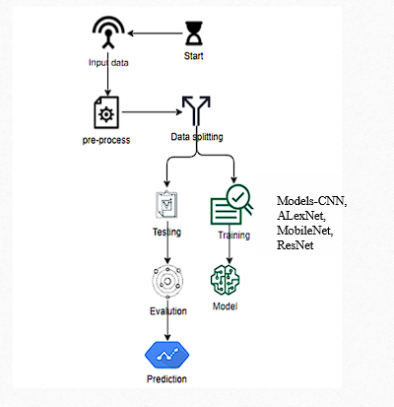
ARCHITECTURE

Slide 25
MODULES
1. System:
User
1.1 Create Dataset:
The knee X-ray image dataset designated for classification is partitioned into training and testing sets, with a test size of 20-30%.
1.2 Pre-processing:
Images undergo resizing and reshaping, ensuring they are in the appropriate format for model training.
1.3 Training:
The pre-processed training dataset is employed to train the model, utilizing the Mobilenet algorithm and incorporating various transfer learning methods to enhance performance.

Slide 26
Modules
Event Detection Module: This is the core of the SED system, where machine learning or deep learning models are applied to the extracted features to identify and classify sound events within each frame. Algorithms like Convolutional Neural Networks (CNNs), Recurrent Neural Networks (RNNs), and their variants are commonly used.
Post-Processing Module: After sound events are detected, this module can refine the results by removing false positives, combining closely spaced detections of the same event, and smoothing the output to produce a more coherent and accurate representation of the detected sound events over time.

Slide 27
Modules
ALEX NET
Model Selection:
Opting for AlexNet due to its historical success in image classification.
Fine-tuning Strategy:
Fine-tuning AlexNet to tailor it for knee osteoarthritis detection.
Initialization with random weights, as AlexNet doesn't have a pre-trained model.
Top Layer Customization:
Adapting the top layers of AlexNet to meet the requirements of multi-class classification in knee osteoarthritis analysis.
Implementation Libraries:
Utilizing TensorFlow and Keras for seamless development.
Leveraging the strengths of these libraries for deep learning model implementation.
Additional Notes:
AlexNet doesn't come with a pre-trained model; therefore, the model is initialized with random weights.
Emphasis on the fine-tuning process for task-specific adaptation.

Slide 28
Modules
MOBILENET
Model Selection: Choosing MobileNet for its efficiency in terms of computational resources and memory, suitable for deployment on resource-constrained devices.
Fine-tuning Strategy: Fine-tuning MobileNet to cater specifically to knee osteoarthritis detection requirements.
Initialization: Initiating the model with random weights as MobileNet doesn't come with a pre-trained model for the given task.
Top Layer Customization: Adjusting the top layers of MobileNet to align with the demands of multi-class classification in knee osteoarthritis analysis.
Implementation Libraries: Employing TensorFlow and Keras libraries for the seamless development of the MobileNet-based model.
Capitalizing on the capabilities of TensorFlow and Keras for efficient deep learning model implementation.
Additional Notes: Emphasizing the resource-efficient nature of MobileNet, making it suitable for deployment in scenarios with limited computational resources.
Highlighting the importance of the fine-tuning process for adapting MobileNet to the specific task.

Slide 29
Modules
RESNET
Model Selection: Opting for ResNet due to its deep architecture, enabling effective feature learning and representation.
Fine-tuning Strategy: Fine-tuning ResNet to tailor it for the nuanced requirements of knee osteoarthritis detection.
Initialization: Initializing the model with random weights, as ResNet doesn't come with a pre-trained model for the designated task.
Top Layer Customization: Modifying the top layers of ResNet to meet the criteria of multi-class classification in knee osteoarthritis analysis.
Implementation Libraries: Utilizing TensorFlow and Keras libraries for the streamlined development of the ResNet-based model.
Leveraging the robust functionalities of TensorFlow and Keras for efficient deep learning model implementation.
Additional Notes: Emphasizing the deep architecture of ResNet, facilitating effective feature extraction in complex medical imaging datasets.
Underscoring the significance of the fine-tuning process to adapt ResNet to the specific requirements of knee
Osteoarthritis detection.

Slide 30
Modules
Training:
Split the dataset into training, validation, and test sets.
Train each model separately on the training set.
Use augmentation techniques to increase the diversity of the training data.
Evaluation:
Evaluate the models using metrics such as accuracy, precision on the validation set.
Model Integration and Testing:
Integrate the models into a system or application.
Test the models on the test dataset and real-world scenarios to assess their practical effectiveness.

Slide 31
UML DIAGRAMS
Use Case Diagram:
A use case diagram in the Unified Modeling Language (UML) is a type of behavioral diagram defined by and created from a Use-case analysis. Its purpose is to present a graphical overview of the functionality provided by a system in terms of actors, their goals (represented as use cases), and any dependencies between those use cases. The main purpose of a use case diagram is to show what system functions are performed for which actor. Roles of the actors in the system can be depicted.

Slide 32
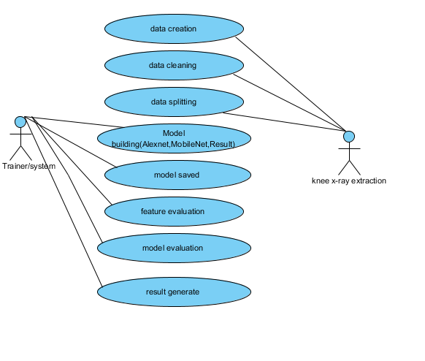
Figure: Use Case Diagram

Slide 33
UML DIAGRAMS
Class Diagram:
In software engineering, a class diagram in the Unified Modelling Language (UML) is a type of static structure diagram that describes the structure of a system by showing the system's classes, their attributes, operations (or methods), and the relationships among the classes. It explains which class contains information.

Slide 34
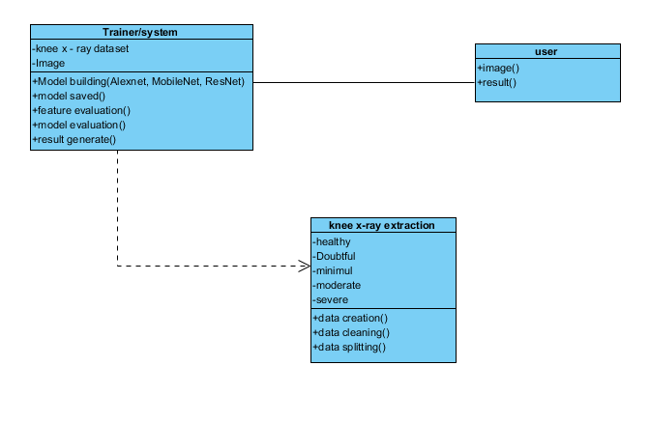
Figure: Class diagram

Slide 35
UML DIAGRAMS
Sequence Diagram:
A sequence diagram in Unified Modelling Language (UML) is a kind of interaction diagram that shows how processes operate with one another and in what order. It is a construct of a Message Sequence Chart. Sequence diagrams are sometimes called event diagrams, event scenarios, and timing diagrams.

Slide 36
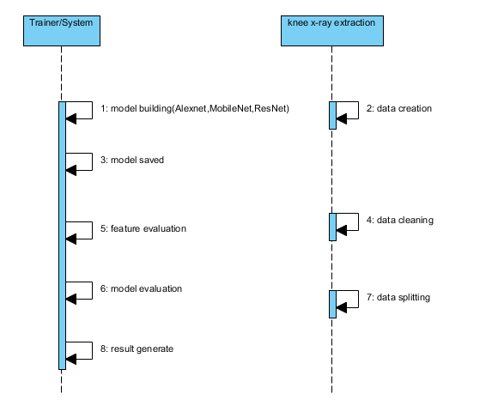
Figure: Sequence diagram

Slide 37
UML DIAGRAMS
Collaboration Diagram:
In collaboration diagram the method call sequence is indicated by some numbering technique as shown below. The number indicates how the methods are called one after another. We have taken the same order management system to describe the collaboration diagram. The method calls are similar to that of a sequence diagram. But the difference is that the sequence diagram does not describe the object organization whereas the collaboration diagram shows the object organization.

Slide 38
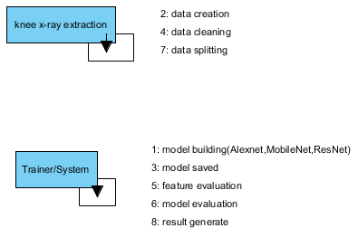
Figure: Collaboration diagram

Slide 39
UML DIAGRAMS
Deployment Diagram
Deployment diagram represents the deployment view of a system. It is related to the component diagram. Because the components are deployed using the deployment diagrams. A deployment diagram consists of nodes. Nodes are nothing but physical hardware’s used to deploy the application.

Slide 40
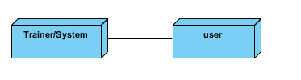
Figure: Deployment diagram

Slide 41
UML DIAGRAMS
Activity Diagram:
Activity diagrams are graphical representations of workflows of stepwise activities and actions with support for choice, iteration and concurrency. In the Unified Modelling Language, activity diagrams can be used to describe the business and operational step-by-step workflows of components in a system. An activity diagram shows the overall flow of control.

Slide 42
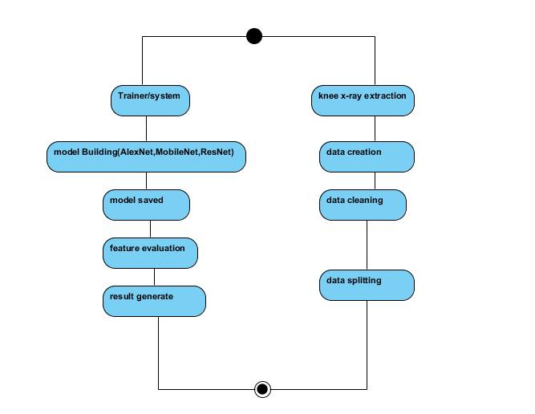
Figure: Activity diagram

Slide 43
UML DIAGRAMS
Component Diagram:
A component diagram, also known as a UML component diagram, describes the organization and wiring of the physical components in a system. Component diagrams are often drawn to help model implementation details and double-check that every aspect of the system's required functions is covered by planned development.

Slide 44
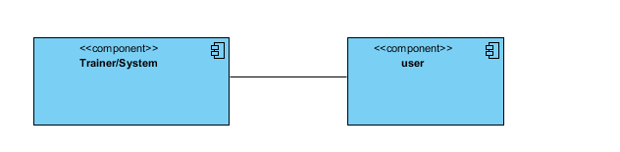
Figure: Component diagram

Slide 45
UML DIAGRAMS
ER Diagram:
An Entity–relationship model (ER model) describes the structure of a database with the help of a diagram, which is known as Entity Relationship Diagram (ER Diagram). An ER model is a design or blueprint of a database that can later be implemented as a database. The main components of E-R model are: entity set and relationship set.
An ER diagram shows the relationship among entity sets. An entity set is a group of similar entities and these entities can have attributes. In terms of DBMS, an entity is a table or attribute of a table in database, so by showing relationship among tables and their attributes, ER diagram shows the complete logical structure of a database. Let’s have a look at a simple ER diagram to understand this concept.

Slide 46
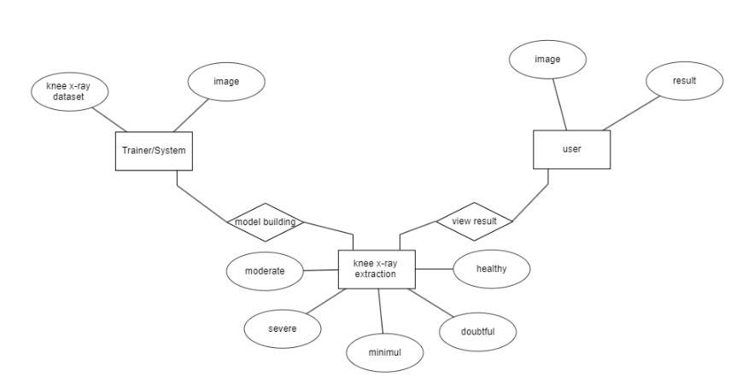
Figure: ER diagram

Slide 47
UML DIAGRAMS
DFD Diagram:
A Data Flow Diagram (DFD) is a traditional way to visualize the information flows within a system. A neat and clear DFD can depict a good amount of the system requirements graphically. It can be manual, automated, or a combination of both. It shows how information enters and leaves the system, what changes the information and where information is stored. The purpose of a DFD is to show the scope and boundaries of a system as a whole. It may be used as a communications tool between a systems analyst and any person who plays a part in the system that acts as the starting point for redesigning a system.

Slide 48
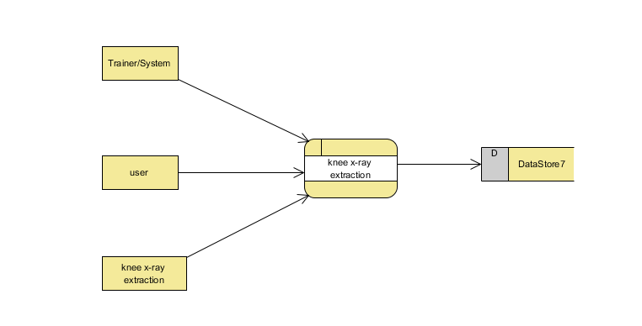
Figure: Context Level diagram

Slide 49
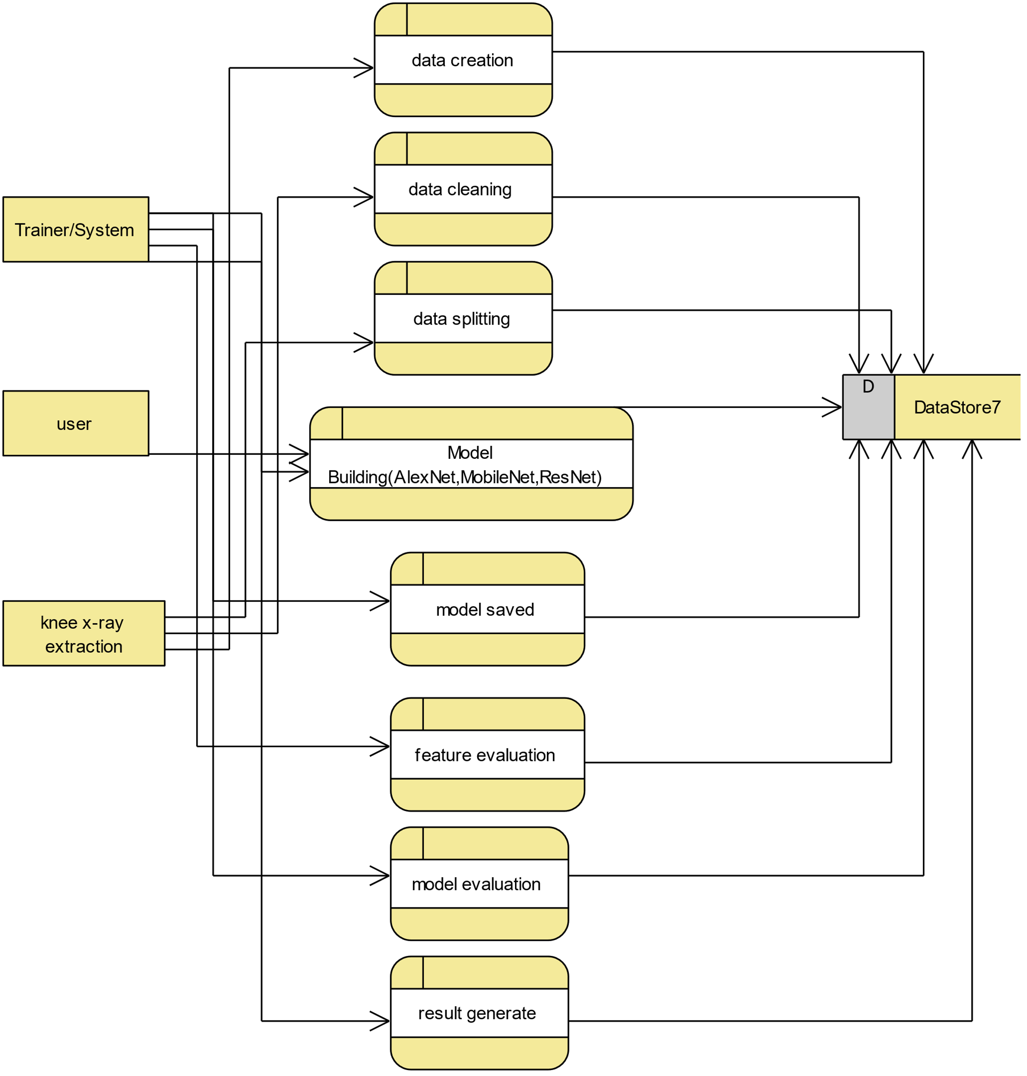
FigureLevel-1 diagram

Slide 50
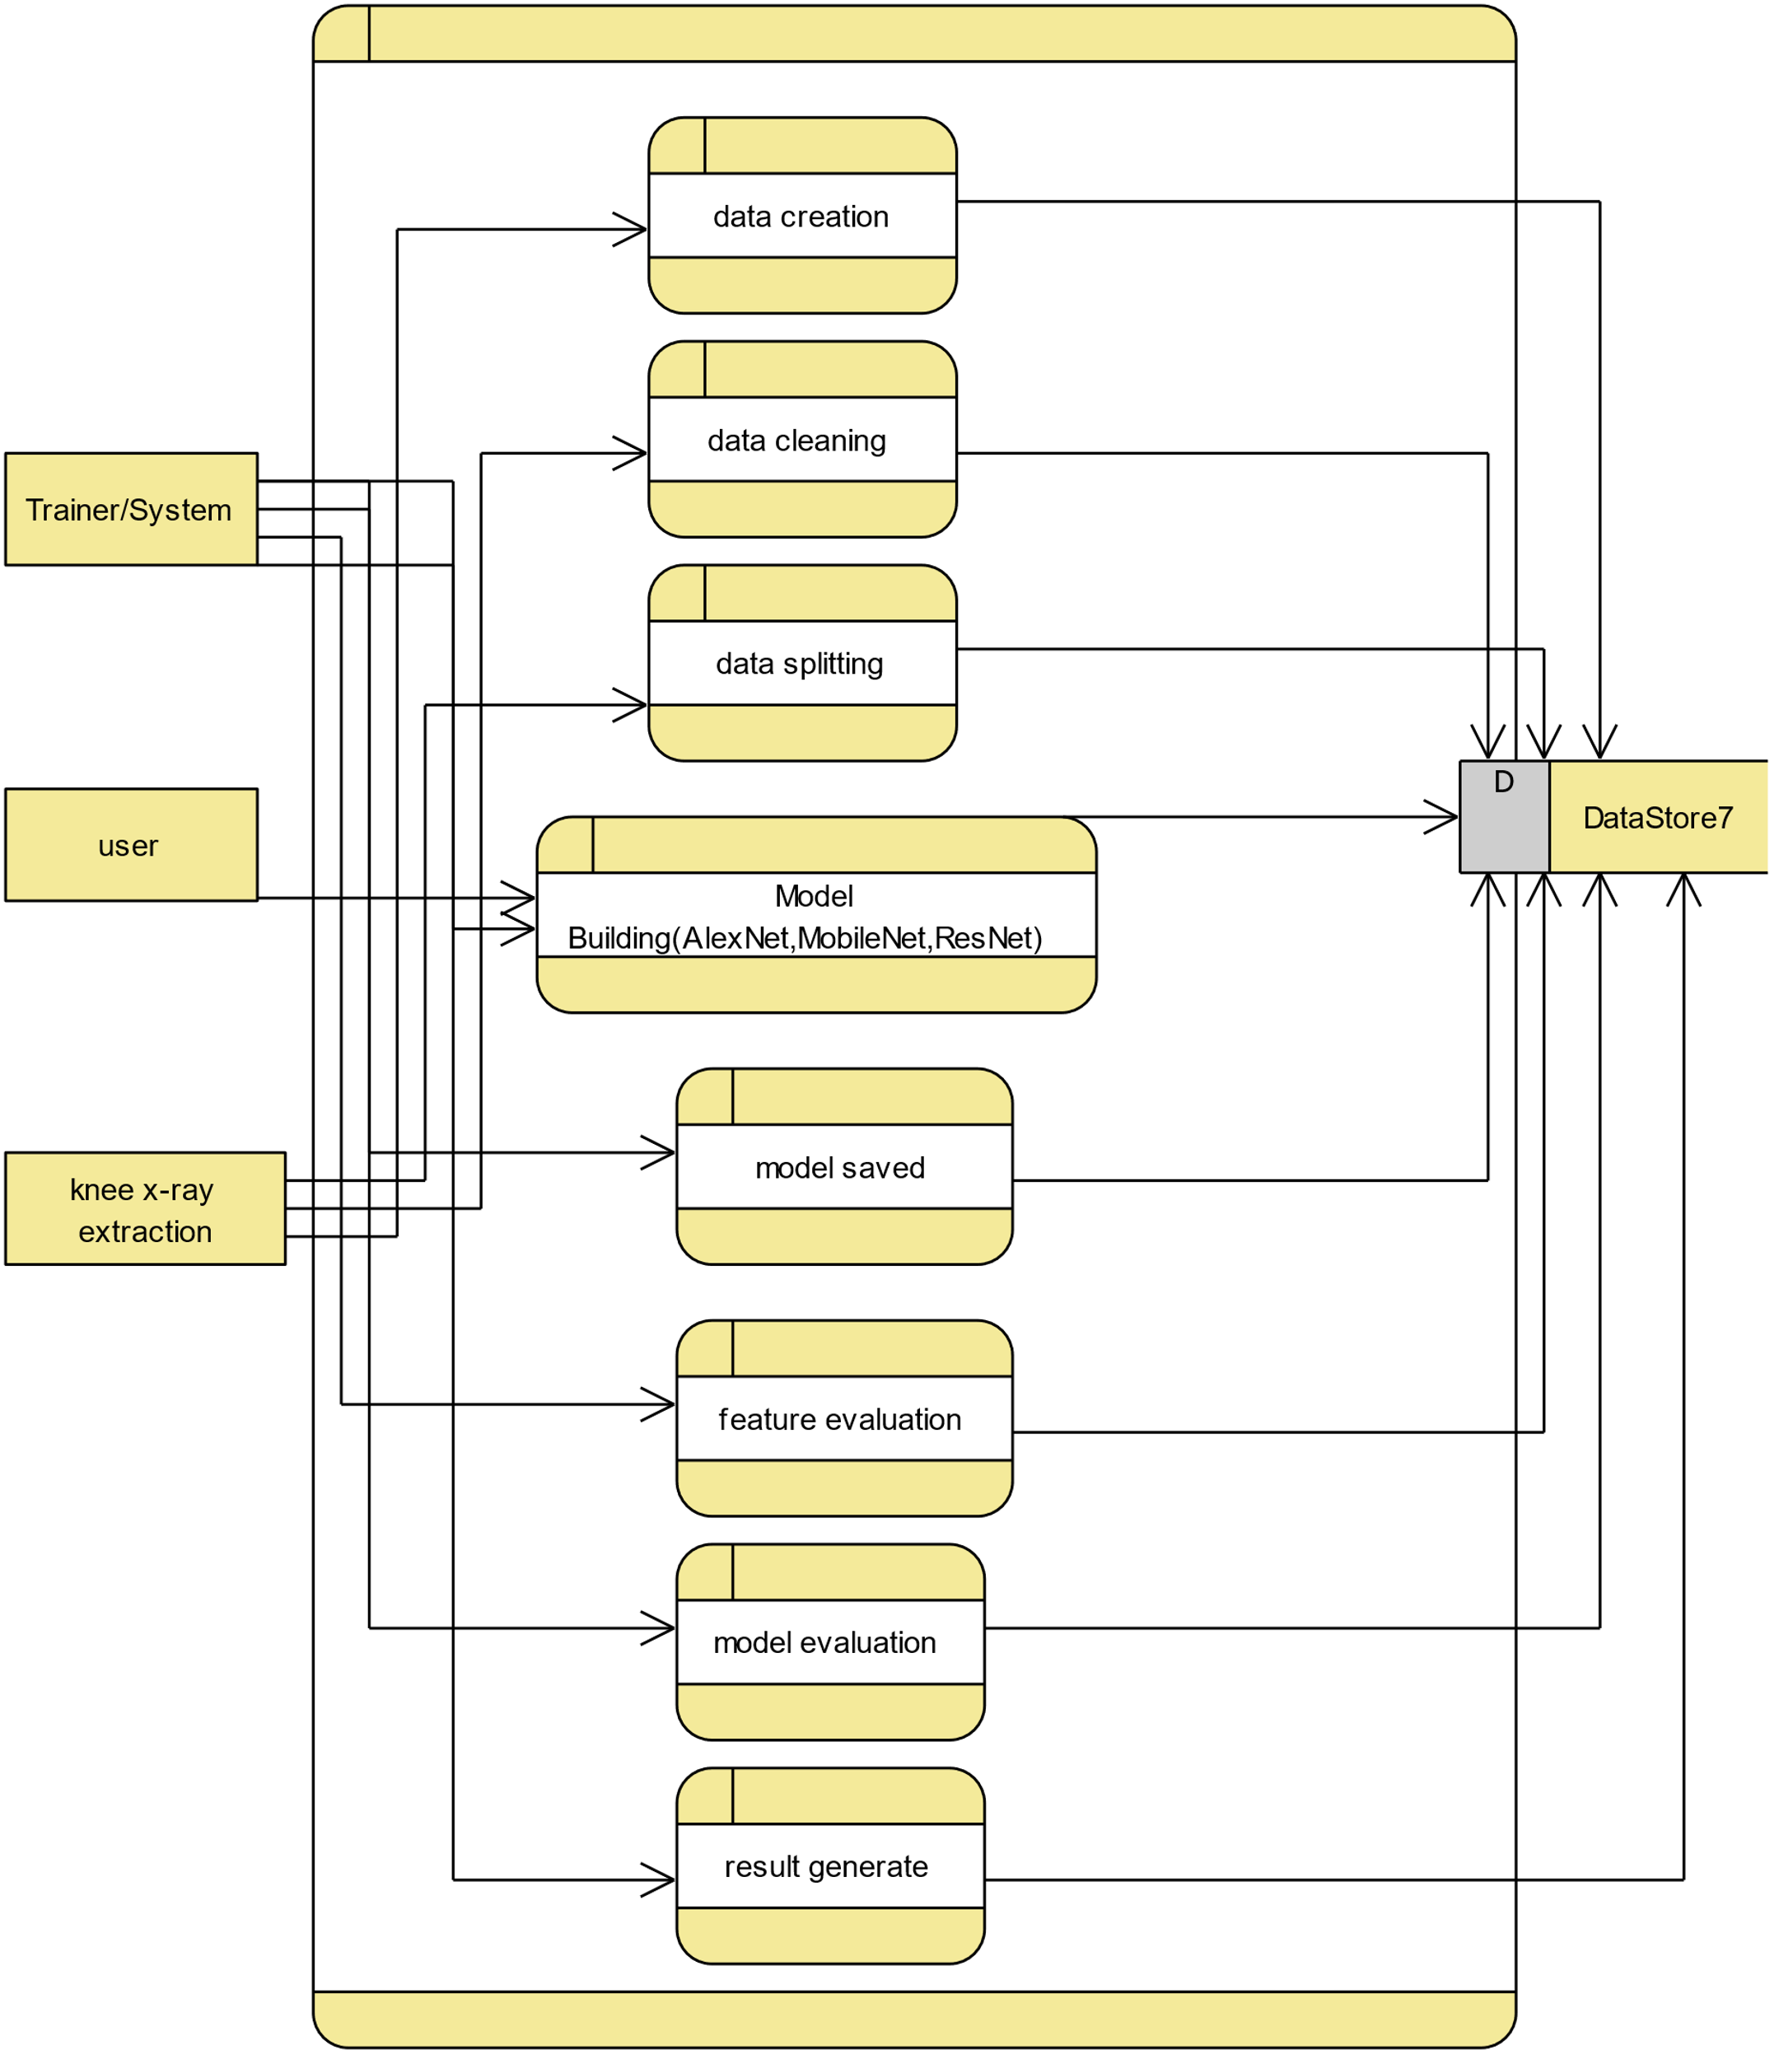
Figure:Level-2 diagram

Slide 51
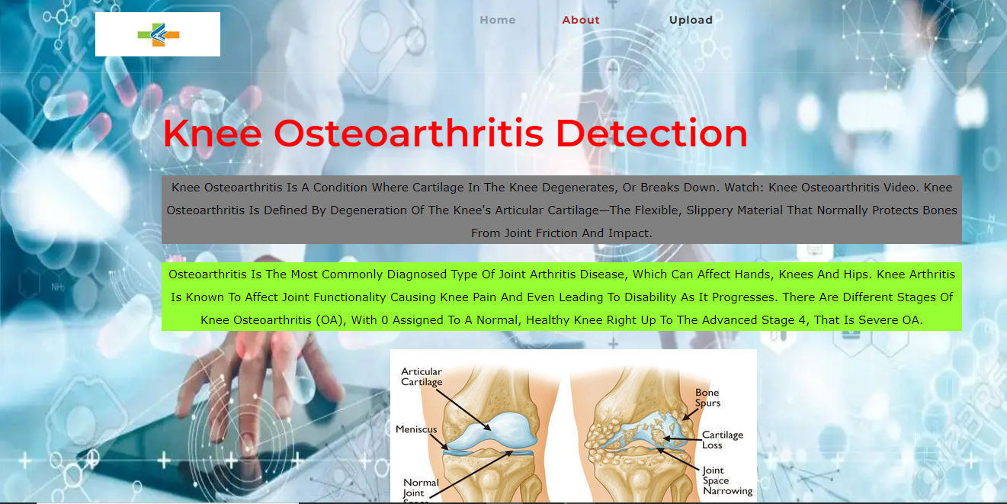
OUTPUT SCREENSHOT
HOME PAGE:

Slide 52
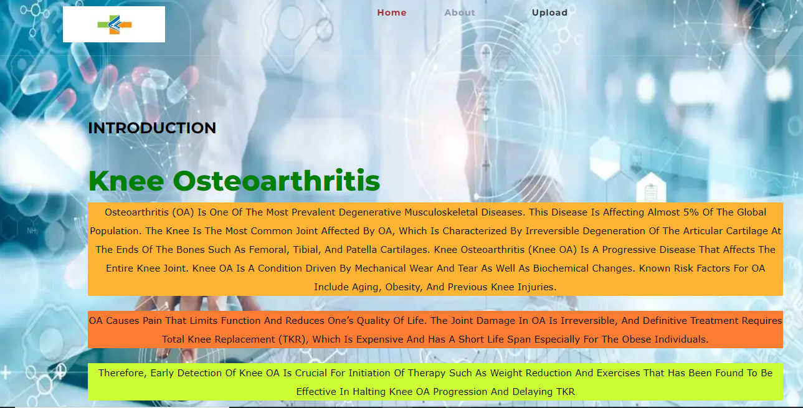
About Page:

Slide 53
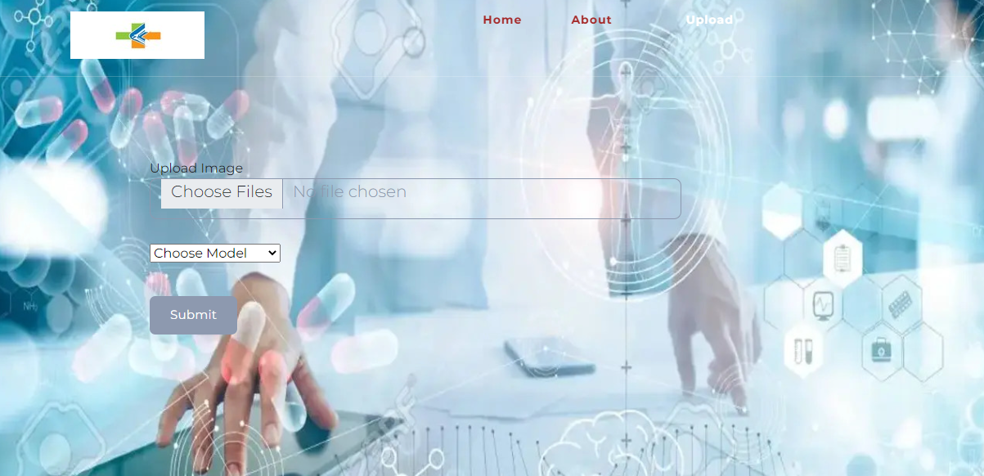
Upload Images:

Slide 54
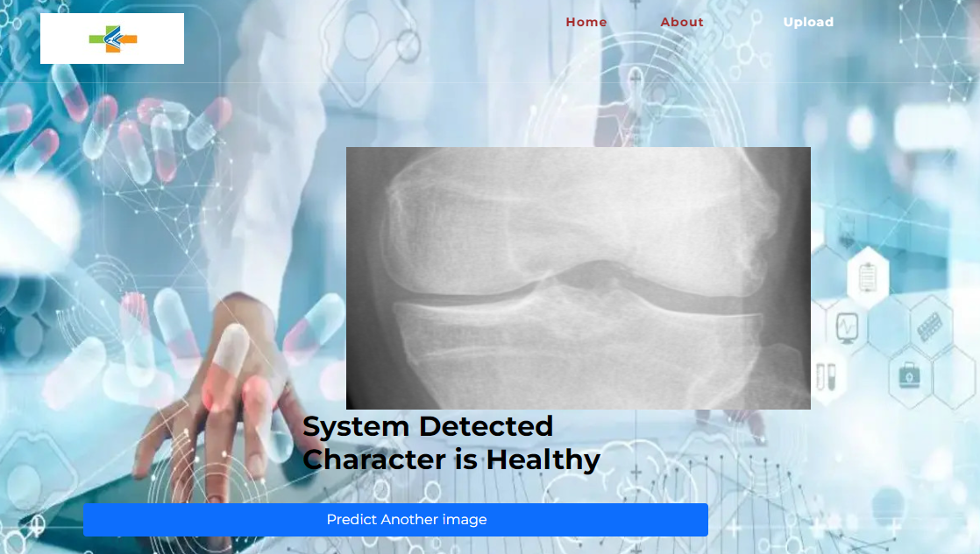
Healthy Image

Slide 55
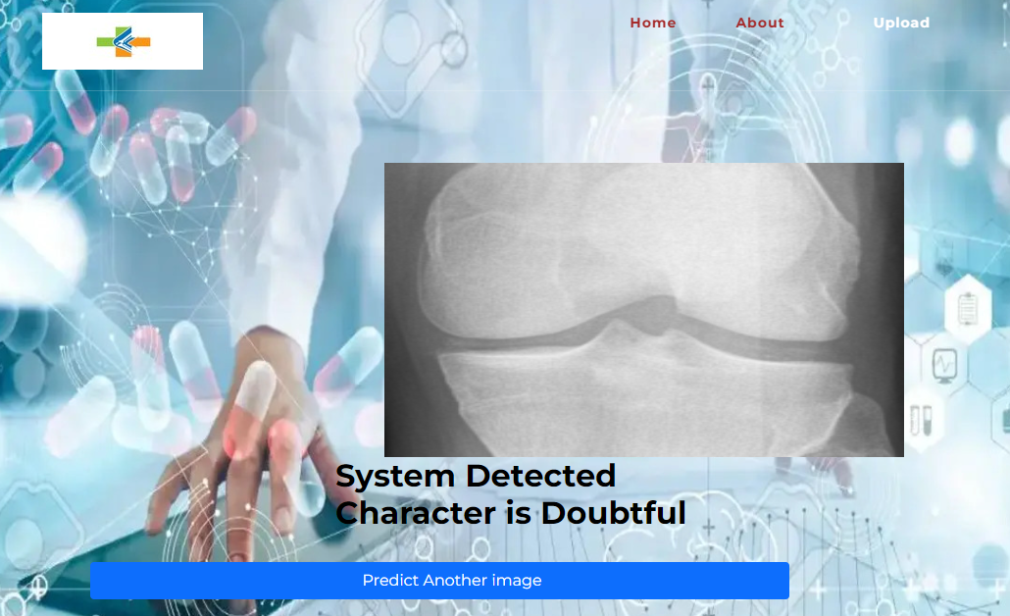
Doubtful Image

Slide 56
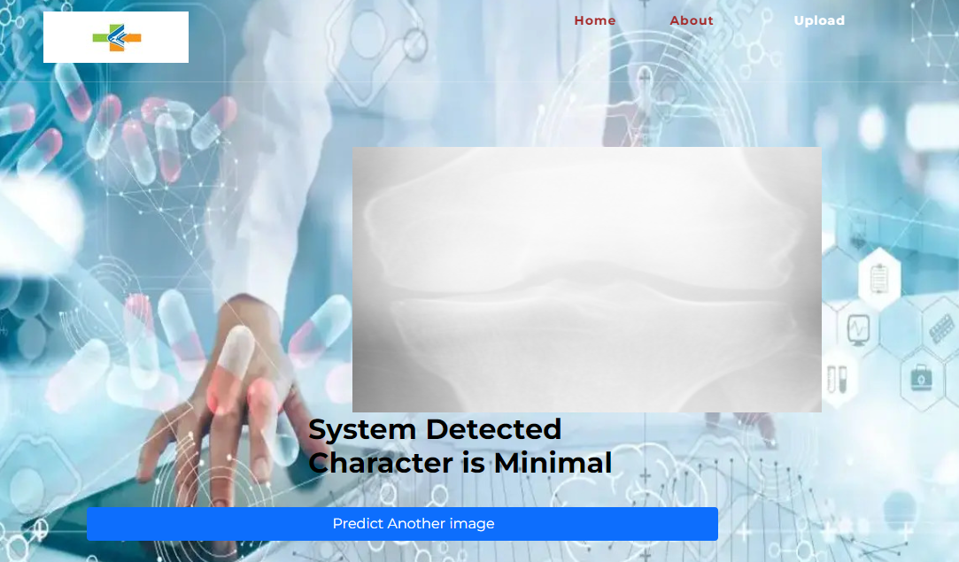
Minimal Image

Slide 57
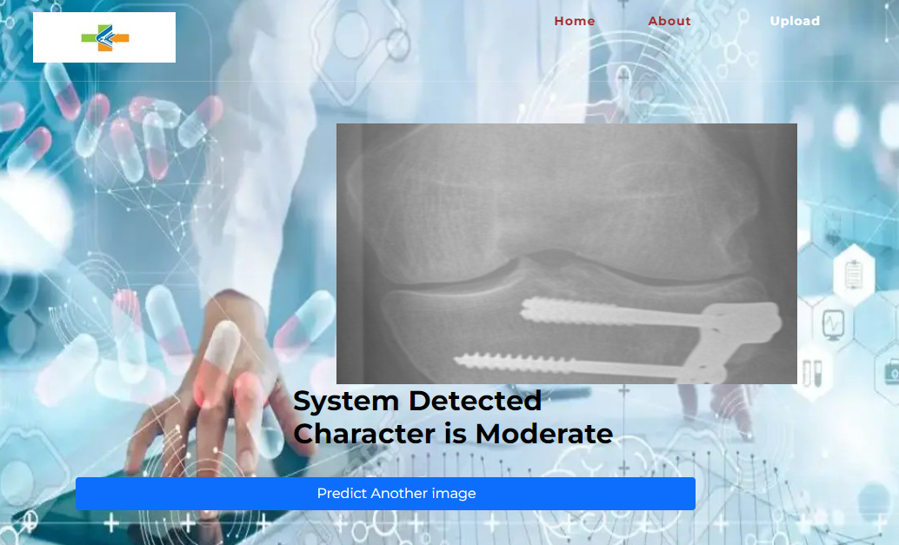
Moderate Image

Slide 58
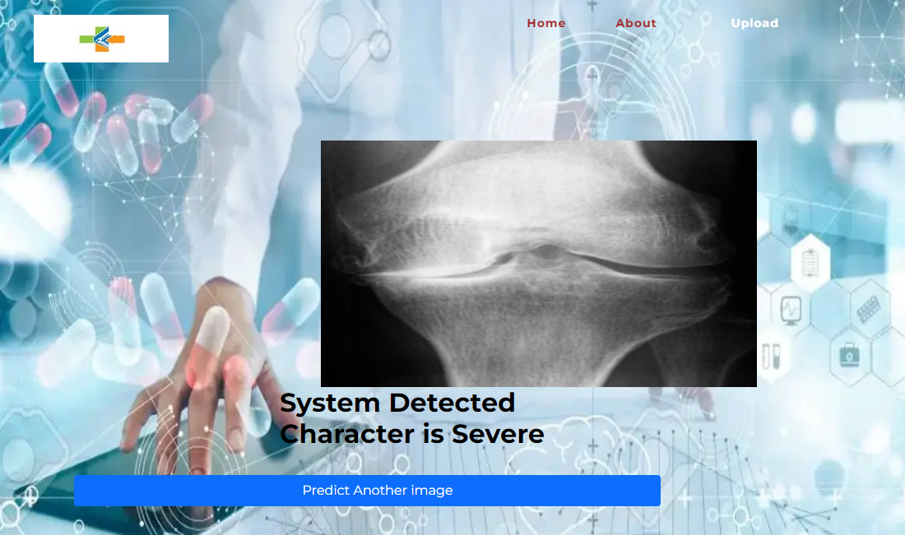
Severe Images

Slide 59
CONCLUSION
In this project we have successfully classified the images of knee X-ray images of a person, is either affected with the pneumonia or normal using the deep learning. Here, we have considered the dataset of knee X-ray images which will be of 2 different types (pneumonia affected and normal) and trained using Mobilenet along with some of the transfer learning methods. After the training we have tested by uploading the image and classified it.

Slide 60
REFERENCES
T. Sivakumari; R. Vani: Implementation of AlexNet for Classification of Knee Osteoarthritis, IEEE (2022)
Anifah, L., Purnomo, M., Mengko, T., Purnama, I.: Osteoarthritis severity determination using self organizing map based Gabor kernel. In: IOP Conference Series: Materials Science and Engineering, vol. 306, p. 012071. IOP Publishing (2018)
Antony, J., McGuinness, K., O’Connor, N.E., Moran, K.: Quantifying radiographic knee osteoarthritis severity using deep convolutional neural networks. In: 2016 23rd International Conference on Pattern Recognition (ICPR), pp. 1195–1200. IEEE (2016)
He, K., Sun, J., Tang, X.: Guided image filtering. IEEE Trans. Pattern Anal. Mach. Intell. 6, 1397–1409 (2013)

